Slide 1
Exceptions
In Python

Slide 2
Error
Compile-time
Run-time
SyntaxError
IndentationError
NameError
…
ValueError
IndexError
ZeroDivisionError
…

Slide 3
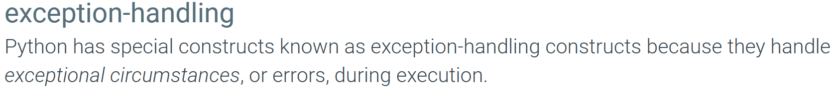
Exception
An exception is an event that occurs during the run-time /program execution
This is an indication that something unexpected has happened
Exceptions are represented by objects in Python

Slide 4
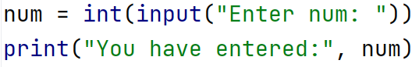
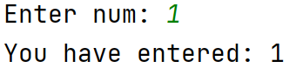
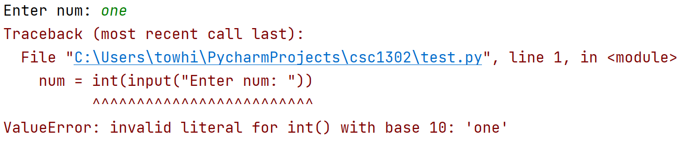
Exception: example scenario

Slide 5
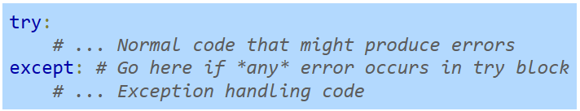
Basic exception-handling constructs
The try and except constructs are used together to implement exception handling

Slide 6
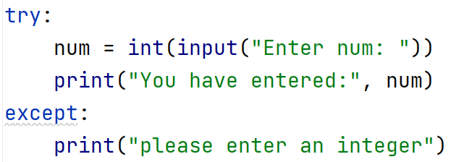
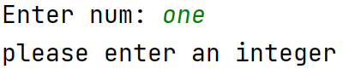
Basic exception-handling constructs

Slide 7
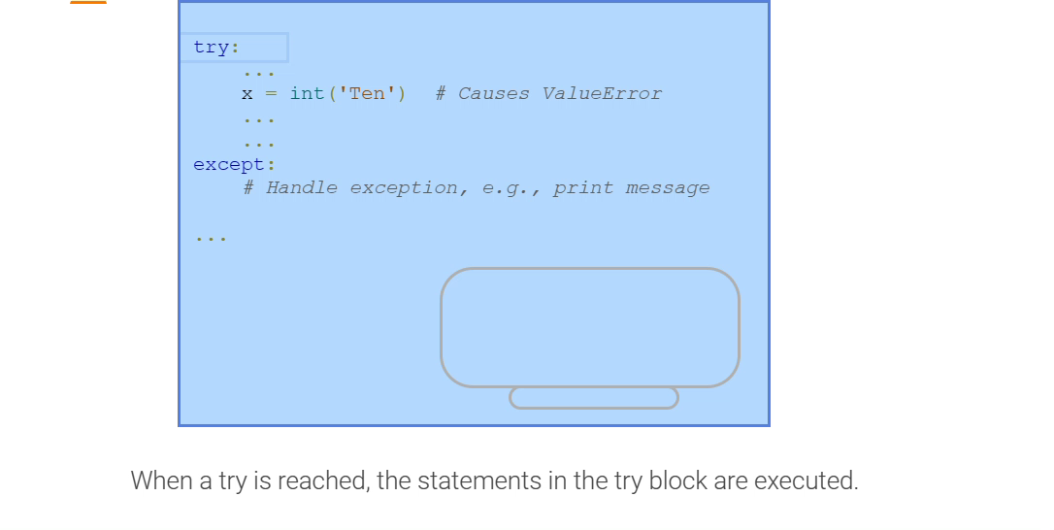

Slide 8
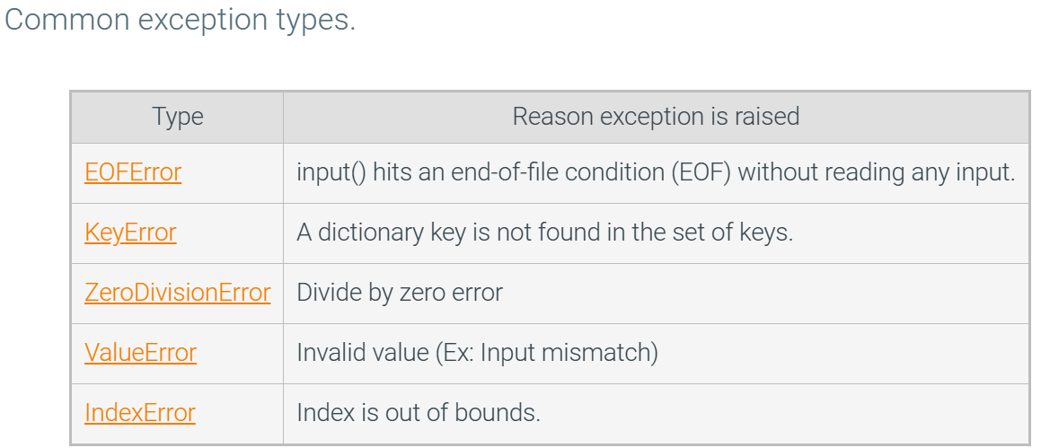
Built-in Exceptions — Python 3.11.4 documentation

Slide 9
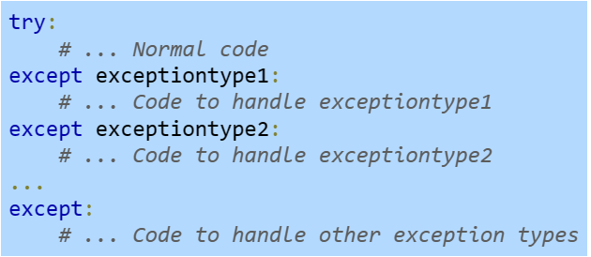
Multiple exception handlers
Sometimes the code in a try block may generate different types of exceptions
Multiple exception handlers can be added to a try block by:
adding additional except blocks
specifying the type of exception that each except block handles

Slide 10
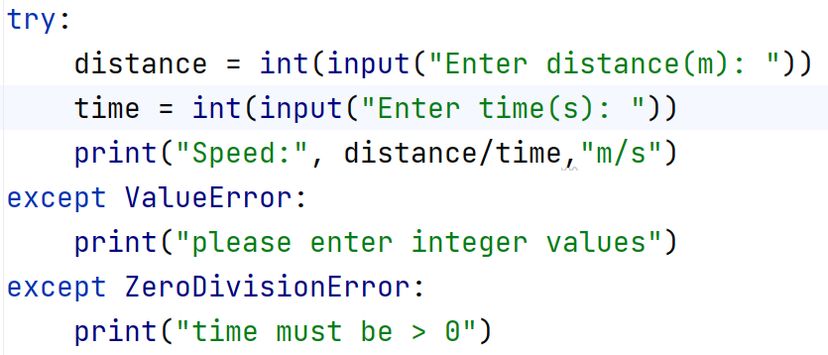
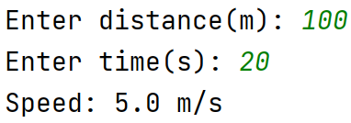
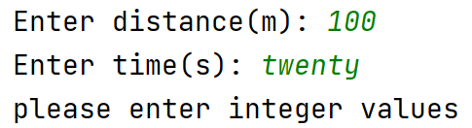
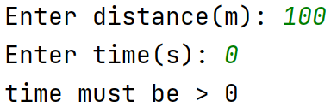

Slide 11
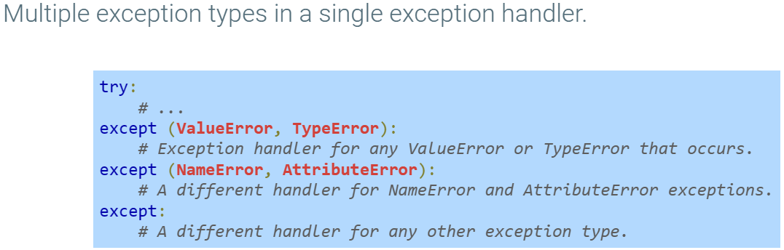
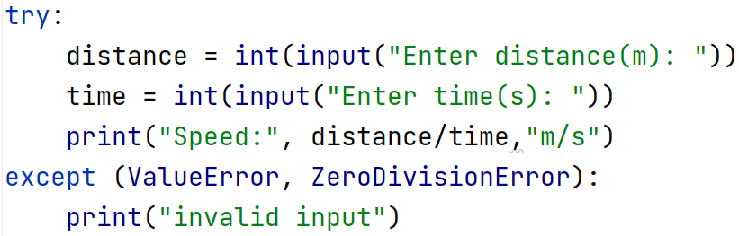

Slide 12
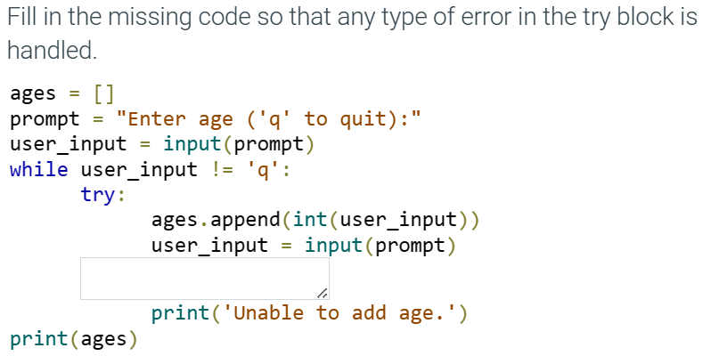
except:

Slide 13
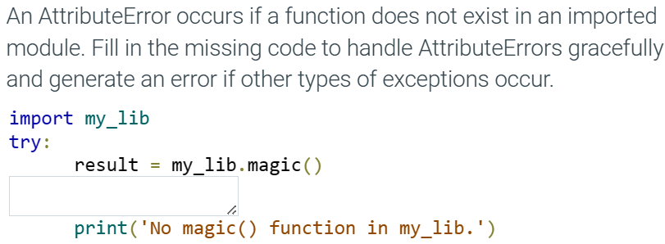
except AttributeError:

Slide 14
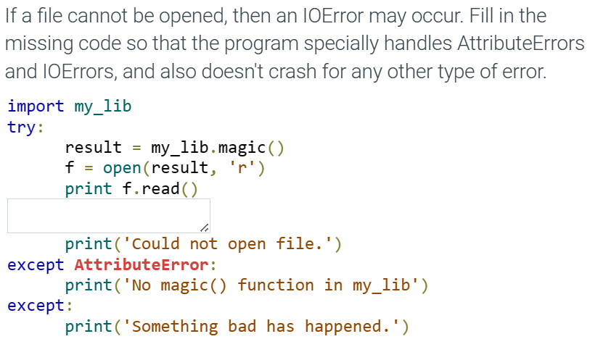
except IOError:

Slide 15
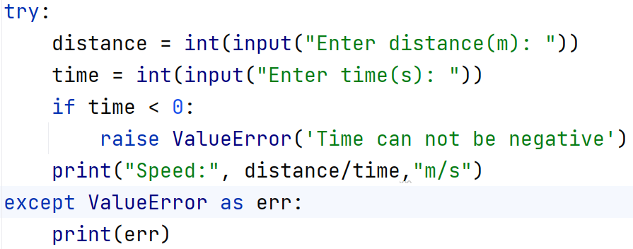
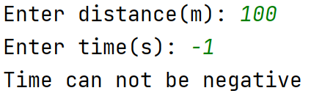
Raising Exceptions
raise ExceptionName(‘message’)

Slide 16
Exceptions with functions
If an exception is raised within a function and is not handled within that function:
the function is immediately exited
the calling function is checked for a handler
and so on up the function call hierarchy
f()
g()
Exception occurs in h()
h()

Slide 17
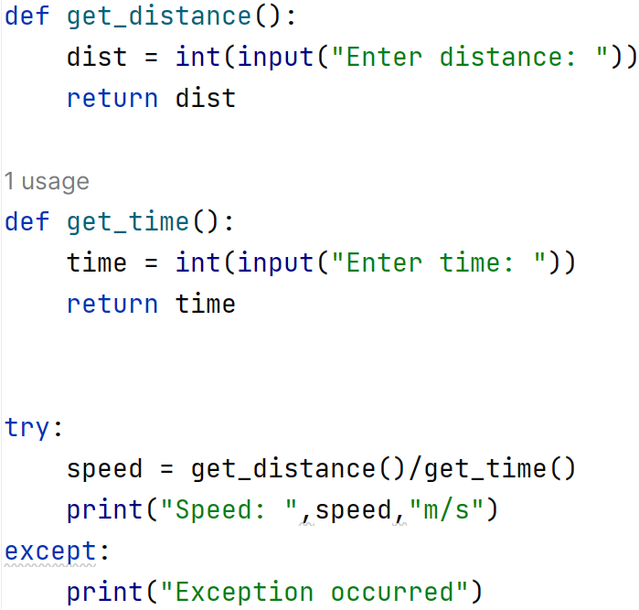

Slide 18
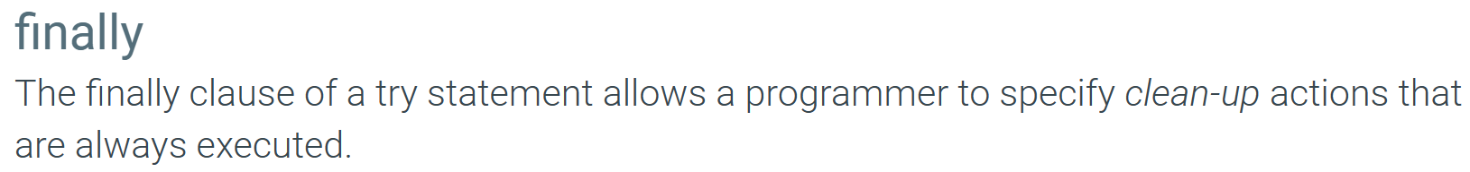
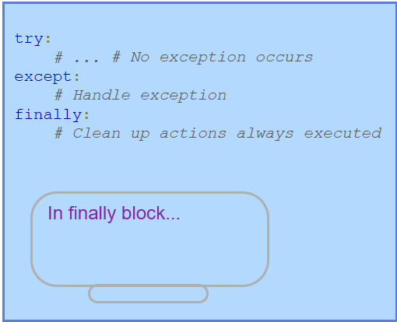
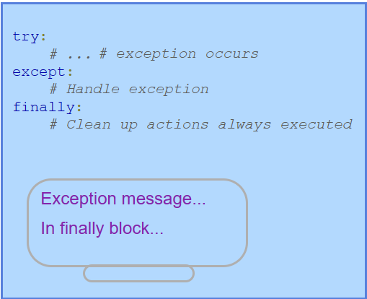

Slide 19
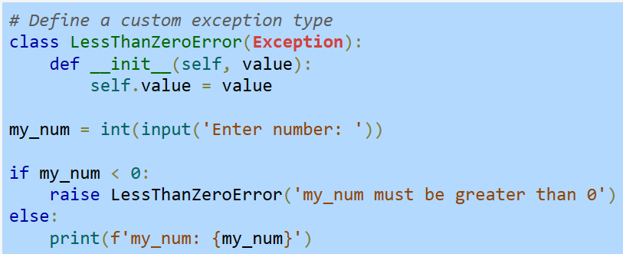
Custom Exception Type

Slide 20
Recommended Reading from ZyBook
10.1 Handling exceptions using try and except
10.2 Multiple exception handlers
10.3 Raising exceptions
10.4 Exceptions with functions
10.5 Using finally to clean up
10.6 Custom exception types

Slide 21
Modules

Slide 22
Module
A programmer may find themselves writing the same function over and over again in multiple scripts
A solution is to use a module - a file containing Python code that can be used by other Python Sources
Python Sources –
Scripts
Other Modules
Interactive Interpreter

Slide 23
Importing Modules
Good practice is to place import statements at the top of a file.
To import a module (MyModule.py): import MyModule
The interpreter first checks to see if that module has already been imported.
A dictionary of the loaded modules is stored in sys.modules
import sys
print(sys.modules)
If a module is not found in sys.modules,
then the module is added and the statements within the module's code are executed.

Slide 24
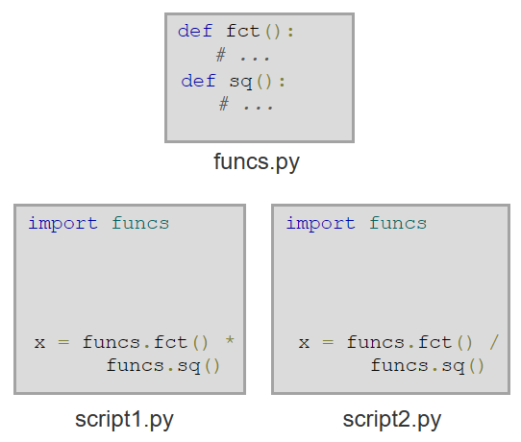
Module

Slide 25
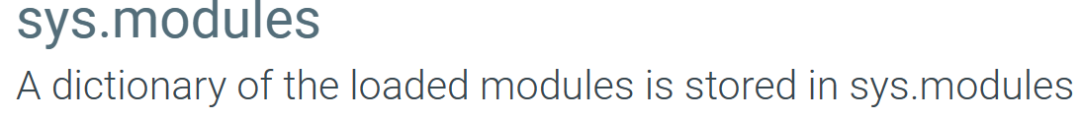

Slide 26
Searching a module
E.g. sys, time, math
Comes pre-installed
Built-in modules
sys.path
A built-in Python variable inside sys module
Has a list of directories containing modules
Stored by the computer’s OS
Can be accessed by any program
Known as “environment variable”
PYTHONPATH

Slide 27
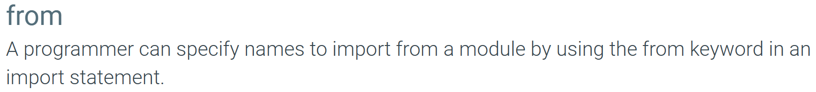
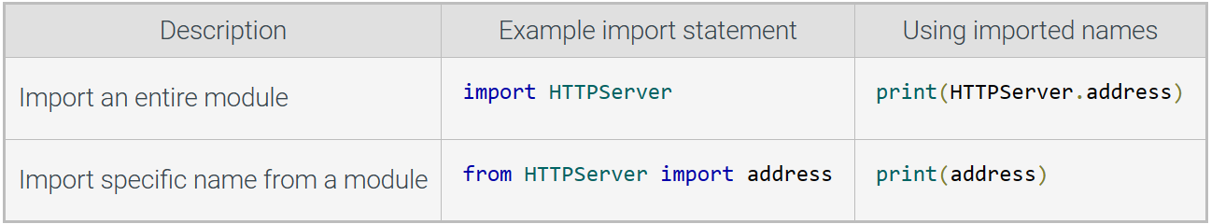
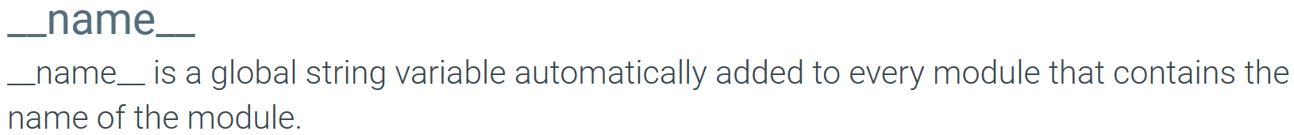
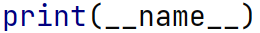
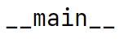

Slide 28
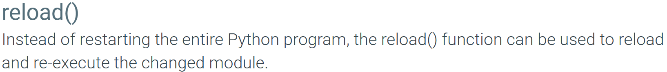
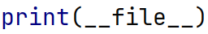

Slide 29
Packages
Instead of importing a single module at a time, an entire directory of modules can be imported all at once
A package is a directory that, when imported, gives access to all of the modules stored in the directory
Large projects are often organized using packages to group related modules.

Slide 30
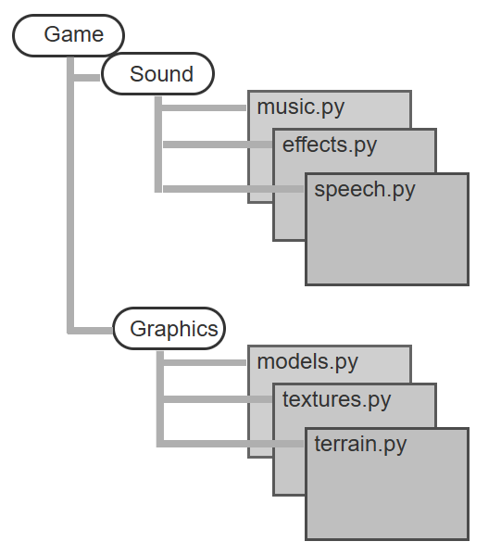
import game.sound.music
import game.sound.effects
import game.sound.speech
import game.sound

Slide 31
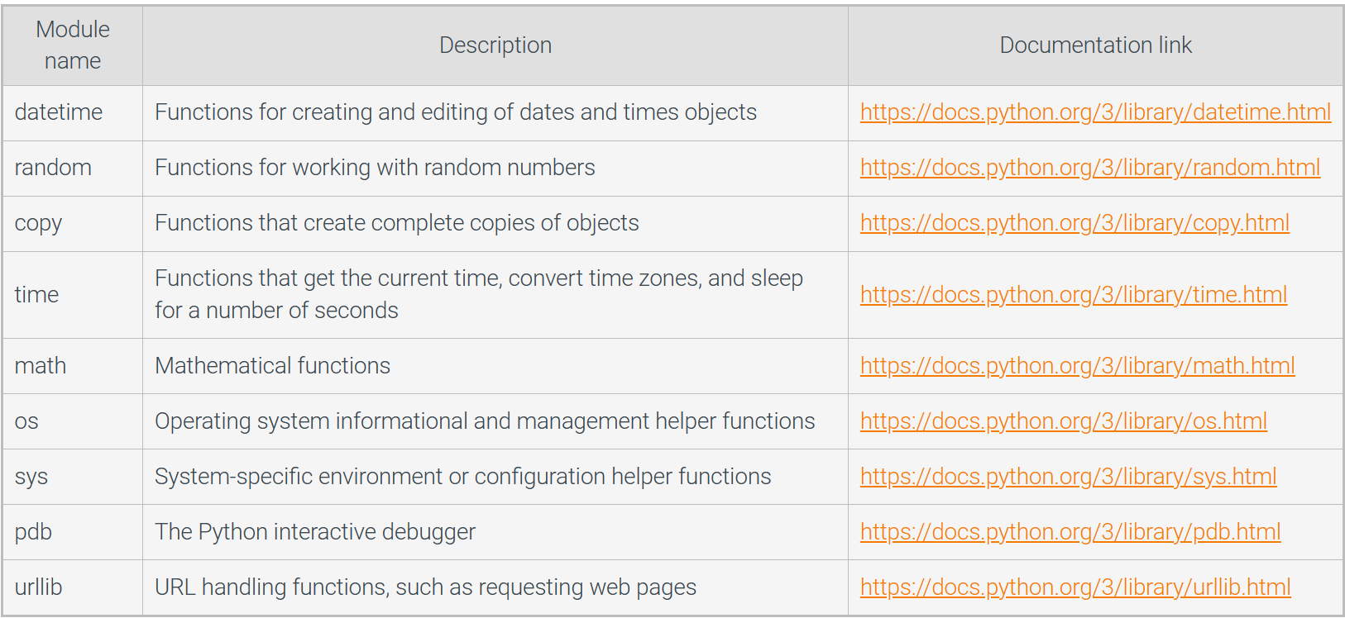
Python Standard Library
Python includes a collection of modules that can be imported into new programs.

Slide 32
Recommended Reading from ZyBook
11.1 Modules
11.2 Finding Modules
11.3 Importing specific names from a module
11.5 reloading modules
11.6 Packages
11.7 Standard Library

Slide 33
Attendance

